Slide 1




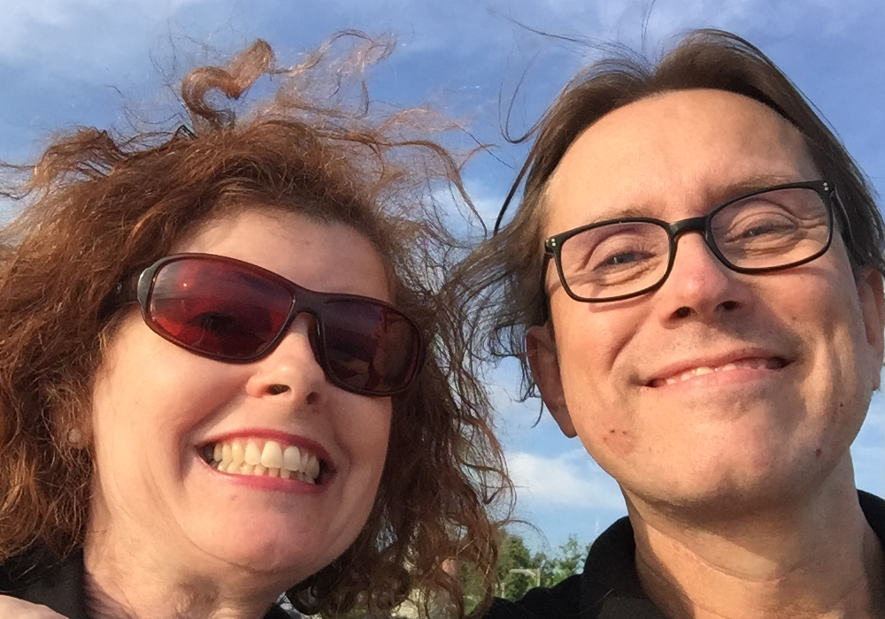
Denise Humphrey & Thorsten Butz
Oh, I'm an Alien
Avoiding the hidden traps of training delivery in foreign languages
Notes:
Description
Most of us MCTs deliver training in either foreign languages and/or foreign countries. English is for many trainers their primary second language – except for those native speakers who frequently deliver their ‘know how’ in foreign countries. We are all part of the ‘global instructor scene’. This workshop is about those things that you never dared to ask and the many things that you are not aware of.
http://mctsummit.eu/wp-content/uploads/2016/10/MCTSUMMIT-17-THESSALONIKI.jpg

Slide 2
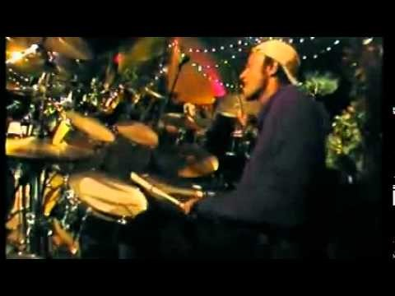
WELCOME TO THE
Dear all,
we had so much fun in Thessaloniki, that we want to share some additional data, solutions, pictures and comments with you¹. Maybe you will like to recap what you saw and heard in Greece. This is for you!
"Be yourself, no matter that they say!"
Sincerly, Denise & Thorsten
✵
¹ We marked the new slides with a gray background.

Slide 3
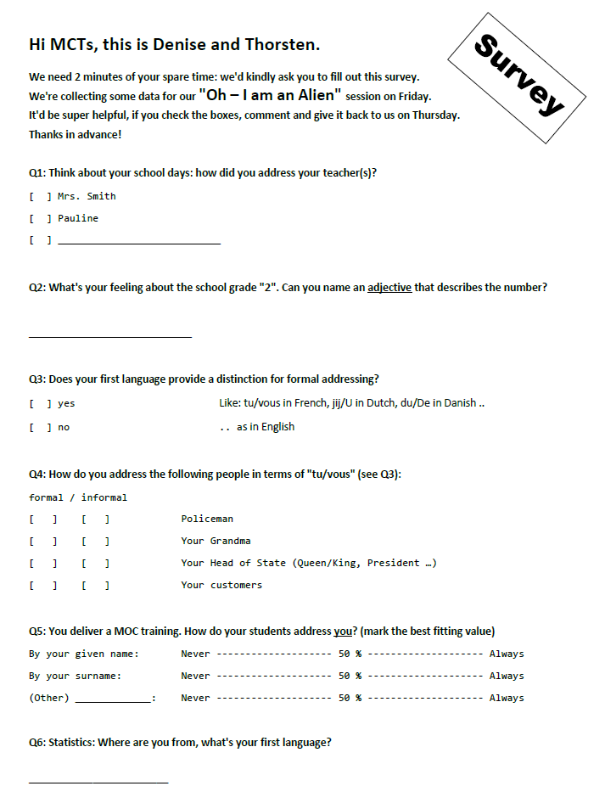
The survey
Thank you for filling out the survey.
We got 50 returned.
These are the results:
This the original survery:

Slide 4
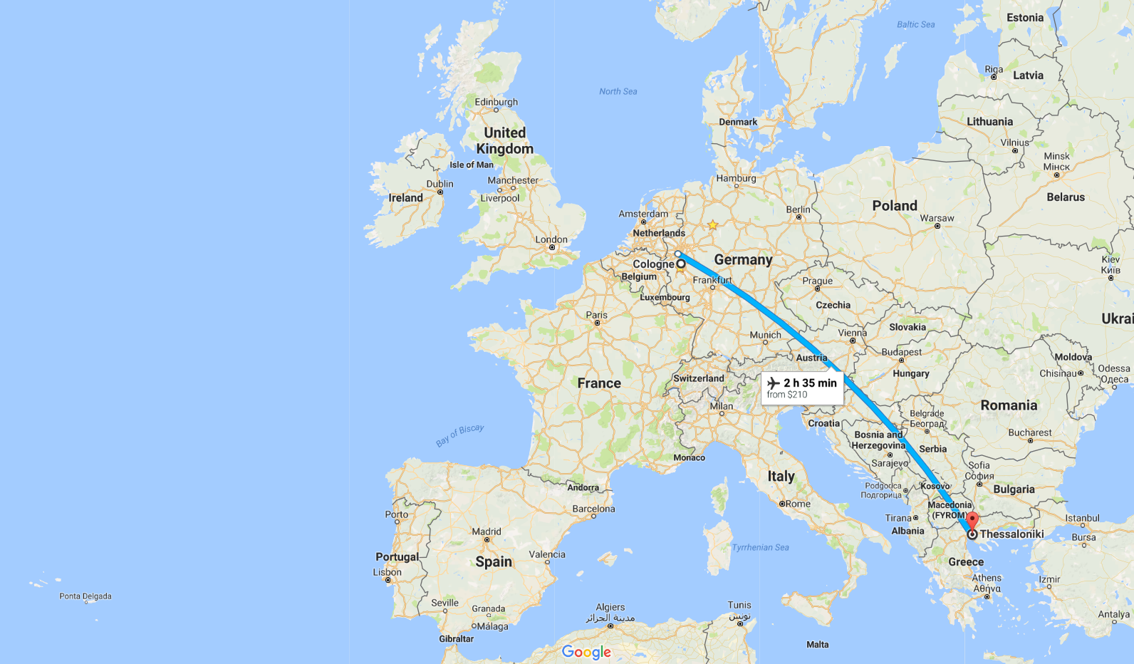
about_speakers
Denise en-GB, tea
Thorsten de-DE, coffee

Slide 5








Efcharistoume our sponsors

Slide 6
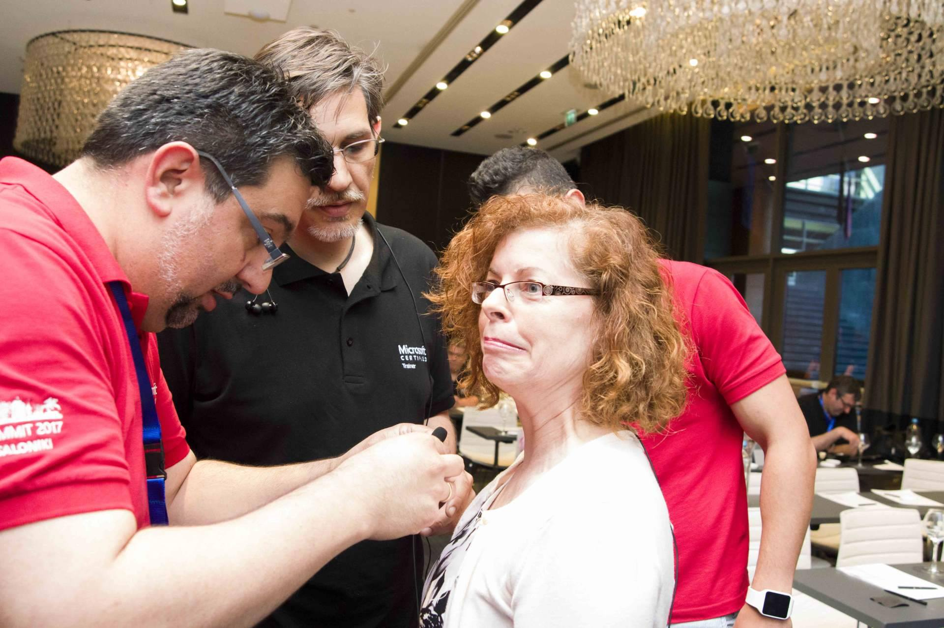
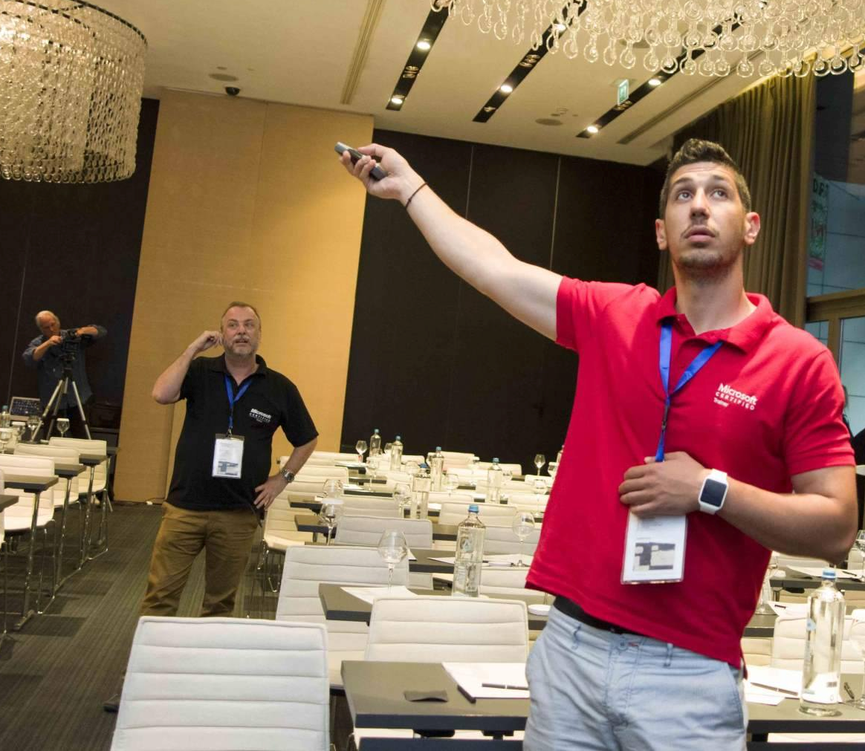
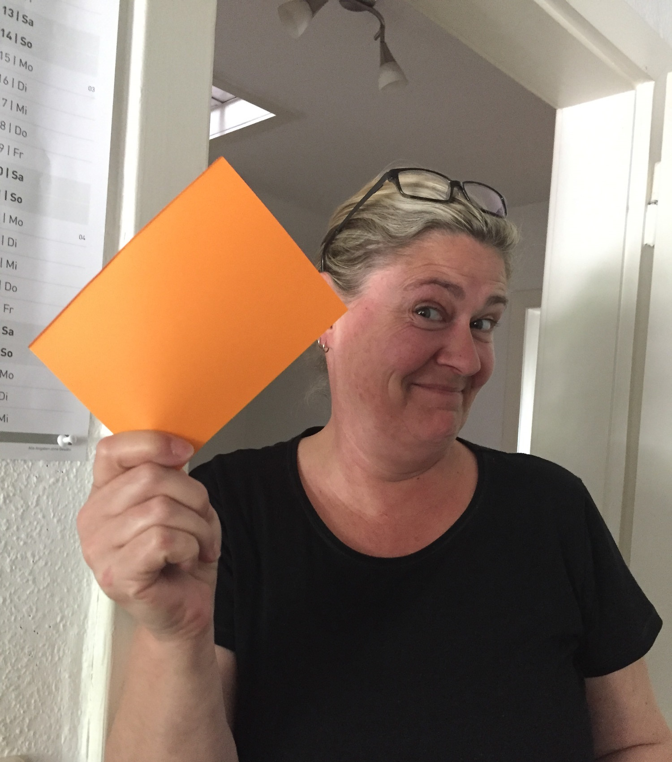
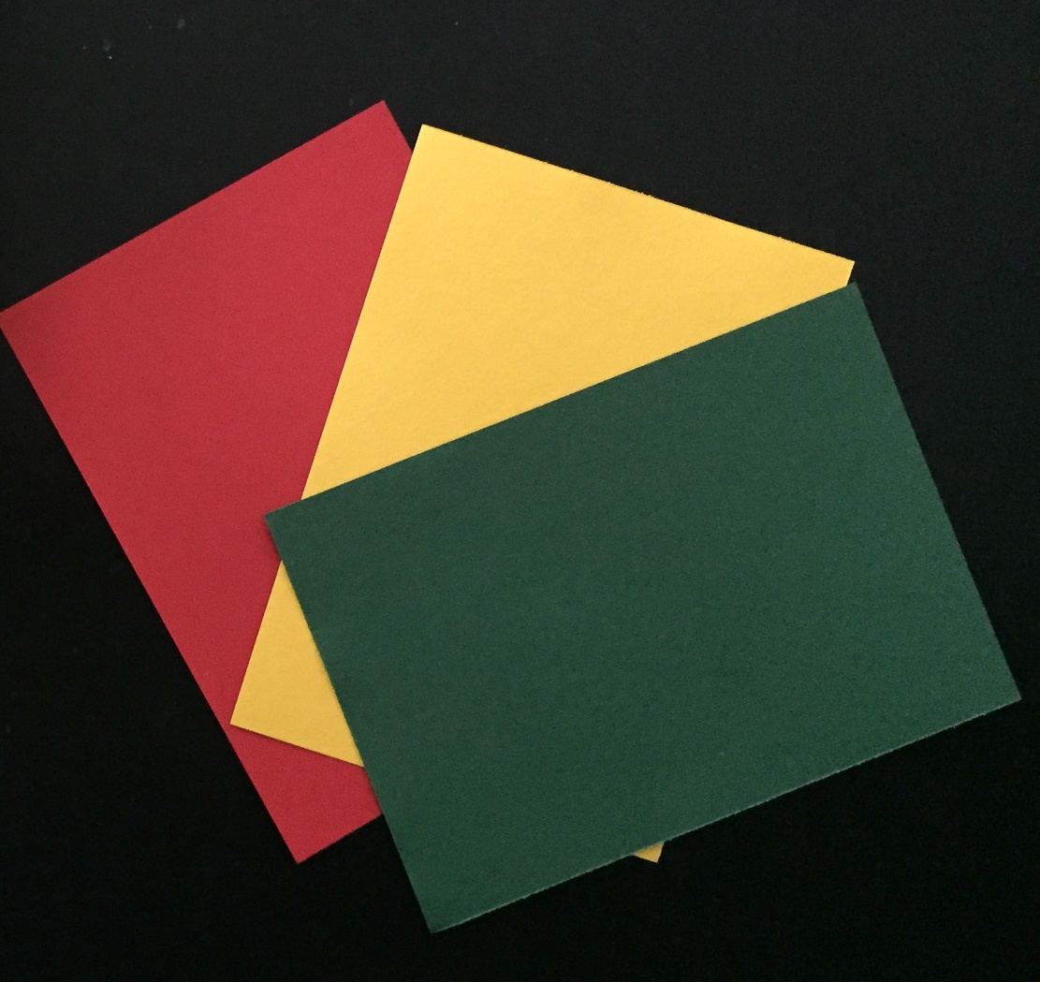
Efcharistoume our helping hands
Notes:
Big hugs.

Slide 7
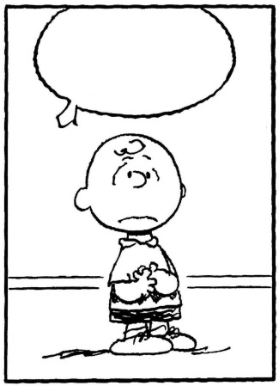
Why?
Notes:
So what gave us the motivation to do this presentation?
We observed things people say and we have completely different opinions on what’s okay and what’s not. Over a few drinks in a bar in Cologne and after some intense conversation, it was clear to us that there are some clear differences in the way people feel about certain words. The way you address people makes a difference to how people treat you in return. Your choice of words and gestures can even affect the overall evaluation of your training. We thought that this might be of interest to you guys as most of us deliver training in other countries.

Slide 8
Ignorance is bliss
Fraternisation
Colloquial vs. gutter language
Educational systems, marks and graduations
Acceptable speech/Joking Gender, sexual orientation, (ethnic) roots, …
Blasphemy
Notes:
During this presentation we will have some fun (hopefully) with various words and cultural differences. Ignorance is bliss of course, but after this session we hope to have at least made you think a little about how important this is and to help you avoid falling into these hidden traps when training in countries where you are less familiar with the culture and what is acceptable language to use in the 'classroom'.
Just because I am native English doesn’t mean I’m safe. I personally have a terrible habit of making silly jokes and wondering why there’s an awkward silence or using words that I’m not sure are even in the dictionary. Then sometimes they are rolling around when I don’t know what I said.

Slide 9
Agenda
In/formal addressing t-v distinction
School grades From 0 to hero
The Don’ts Parental advisory

Slide 10
Chapter 1: the t-v distinction
Latin: tu / vos
French: tu /vous
Spanish: tú / usted
Italian: tu /Lei
Portugese: tu / você …
German: du / Sie
Dutch: je,jij / U
Danish: du / De
Finnish: sinä / Te …
Notes:
https://sites.google.com/site/tvdistinction/home/introduction
The linguists use the term tu-vous.
Are you aware of the Tu – Vous distinction? Does your country have one?
We’ve listed a few of the more well known t-v distinctions. This is something that is tricky for me.
I train quite often in Germany and Switzerland - luckily it's always in English. But that doesn’t mean I won’t fall into any traps as a word that has no offence to me, may have offence for others.
Even though I am aware for example that in Germany you are expected to address a person as Frau or Herr until they 'invite' you to use their first name, I always introduce myself as Denise. These days people are more relaxed about that, but does this mean that I'm open for a drink after training? I find this very hard as the English language doesn’t have this distinction. So in most countries if you’re an alien you need to check

Slide 11
Common Misunderstandings
“Thou comest in such a questionable shape”
William Shakespeare: Hamlet (ca. 1600)
Notes:
https://sites.google.com/site/tvdistinction/home/introduction
Brief summary:
Just out of interest, during the lifetime of Shakespeare, English did provide a "t-v" distinction. They used 'thou' and 'you'. Do you know which would have been formal and which informal?
"thou" represents the informal, familiar address in contrast to "you", the formal style which later on derived as the general purpose pronoun.
We cannot convey the feeling that is in this statement in England, as we would say you. But in Shakespeare’s day Hamlet is actually disrespecting his father with the word thou. The meaning is subtle

Slide 12










Liberté, égalité, fraternité
?
Strict use of "v"
1960s
Du-reformen
Time
Notes:
Can you guess how many countries/languages have a distinction? Almost any language.
https://en.wikipedia.org/wiki/Libert%C3%A9,_%C3%A9galit%C3%A9,_fraternit%C3%A9-
Late 1960s: https://en.wikipedia.org/wiki/Du-reformen
Btw: In 1967 Sweden also switched from left to right driving:
https://en.wikipedia.org/wiki/Dagen_H

Slide 13
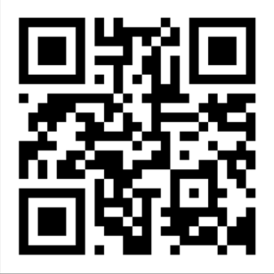
Vote now! http://etc.ch/5FqX
Which country (language) does use the strictest distinction of formal addressing from your experience/opinion ?
RESULT: https://directpoll.com/r?XDbzPBd3ixYqg8kXI04YoJO41aGvRcAgTvZmBrBs
Notes:
http://directpoll.com

Slide 14
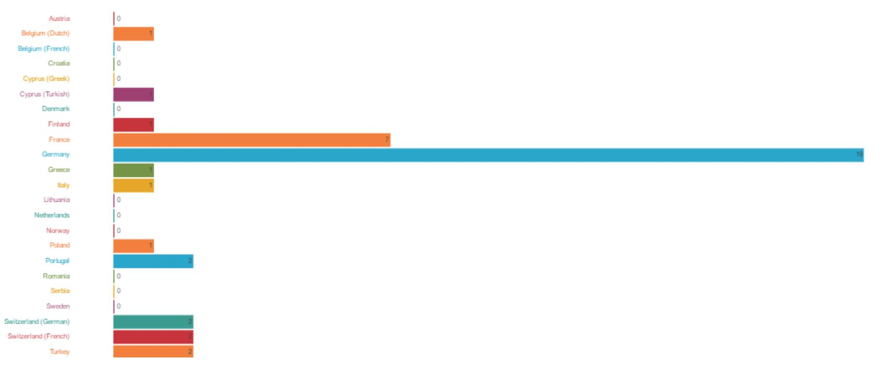
The results from the live vote
Top results:
Germany (19 votes)
France (7 votes)
Switzerland/German Switzerland/France Turkey (2 votes each)
Notes:
https://dp1.directpoll.com/r?XDbzPBd3ixYqg8kXI04YoJO41aGvRcAgTvZmBrBs

Slide 15
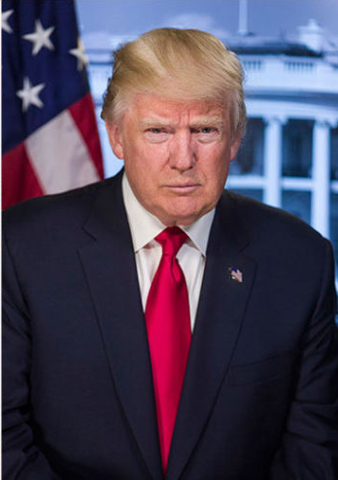

Wassup, Donald?
Notes:
https://upload.wikimedia.org/wikipedia/commons/5/56/Donald_Trump_official_portrait.jpg
Although the English language may not provide a t-v distinction nowadays, there is definitely a code in adressing people. Isn't it?
We can say wassup Donald to Donald Duch, but can we say it to Donald Trump?

Slide 16
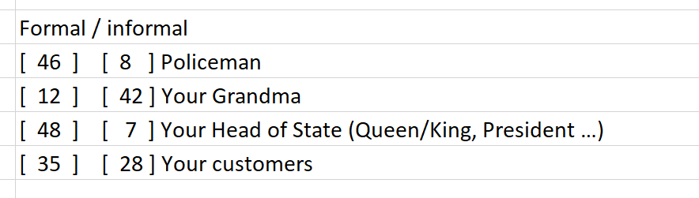
Your mileage varied
Notes:
Taken from the survey. Amazingly, some people chose more than one.

Slide 17
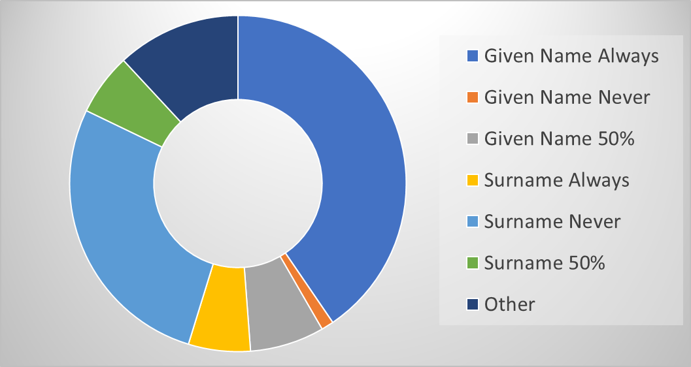
How do people address you in the ‘classroom’?
Notes:
Given Name 50% represents when people have said they do either

Slide 18
Resumee, Chapter 1
The absence of distinct rules of formal addressing, does not make it "easy" adjust your "tone".

Slide 19
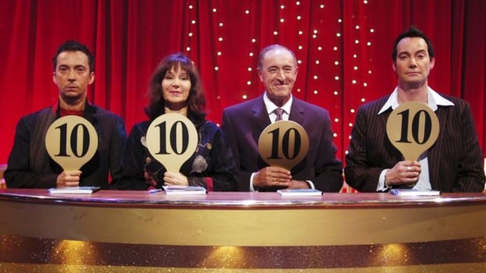
Chapter 2: Scoring
Notes:
https://ichef-1.bbci.co.uk/news/624/cpsprodpb/234D/production/_90373090_strictlyoriginals.jpg

Slide 20
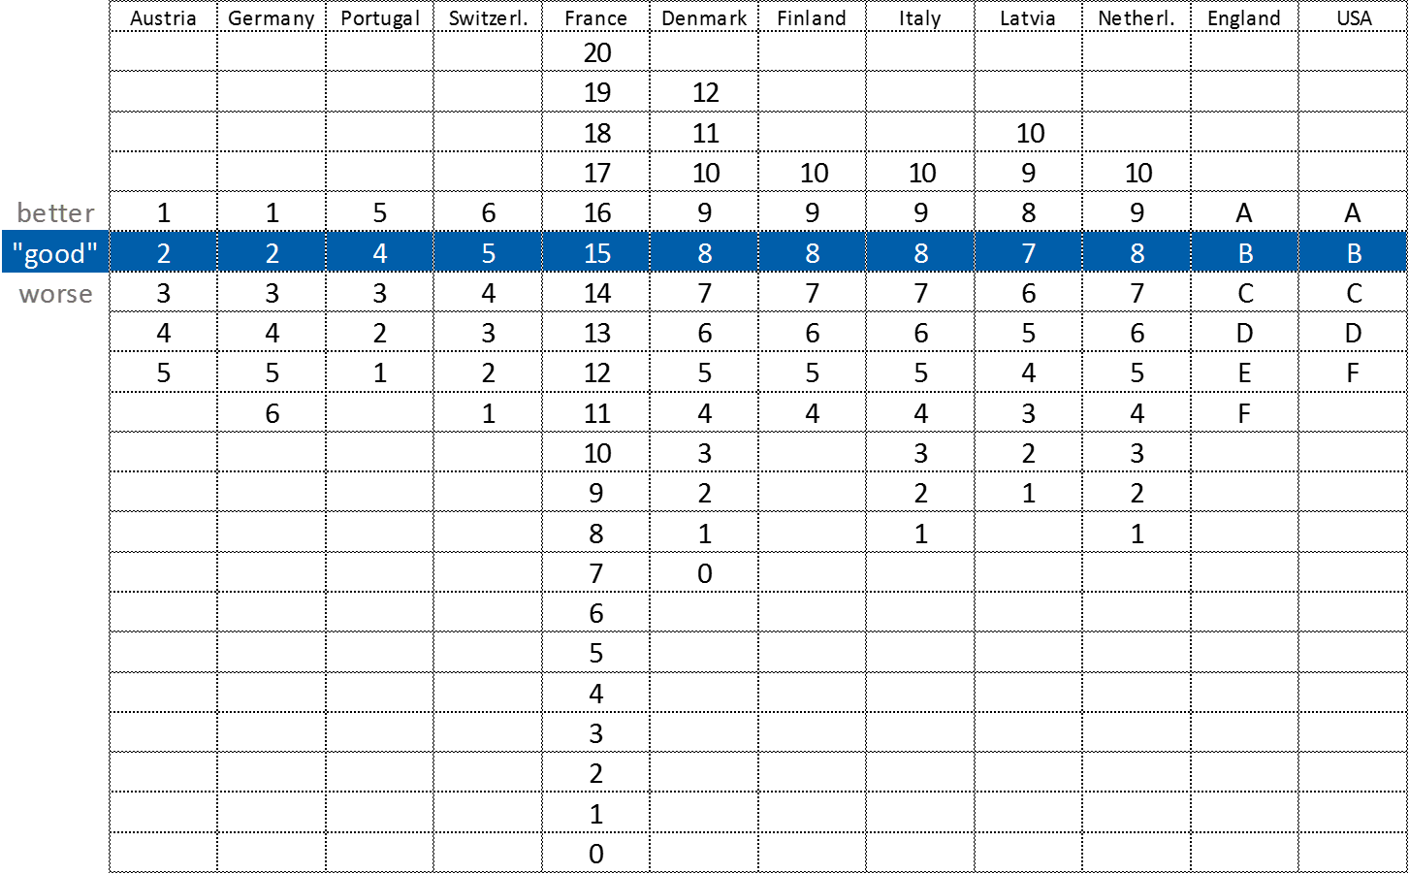
School grades
Notes:
This is important when you are sending your CV to other countries. Your grades could look really bad when actually they are excellent.
In some cultures you will never get a 9. A 7 or even a 6 is often considered excellent. Who wins the gold medal, the number 1 or the number 9?

Slide 21
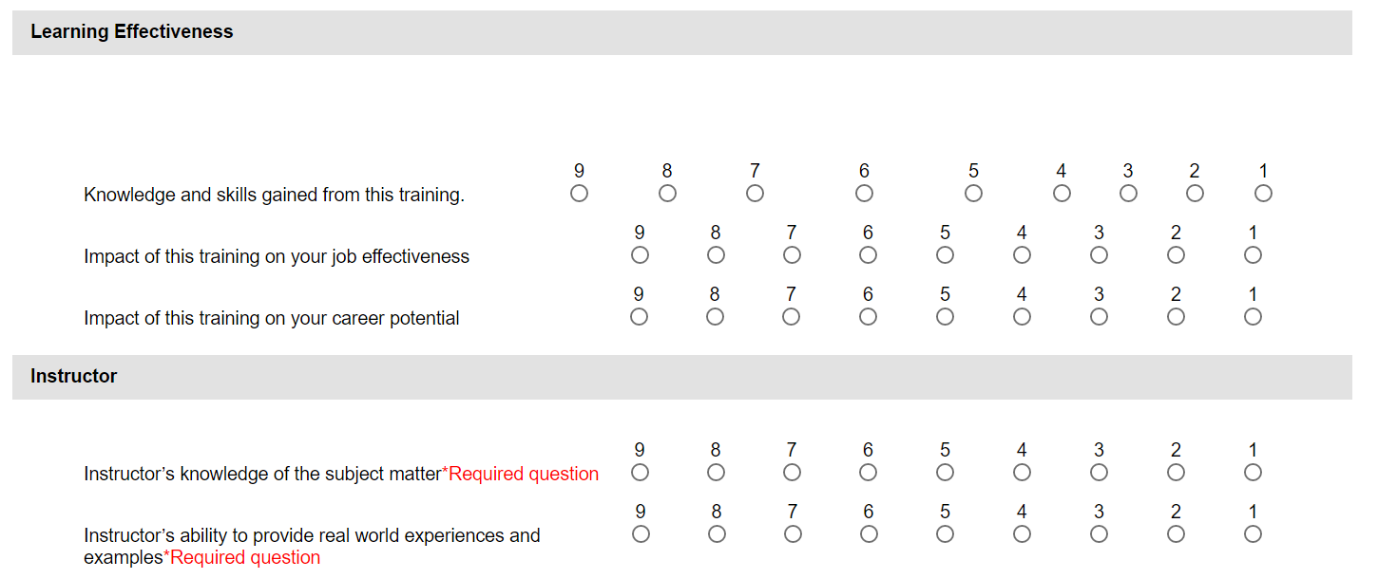
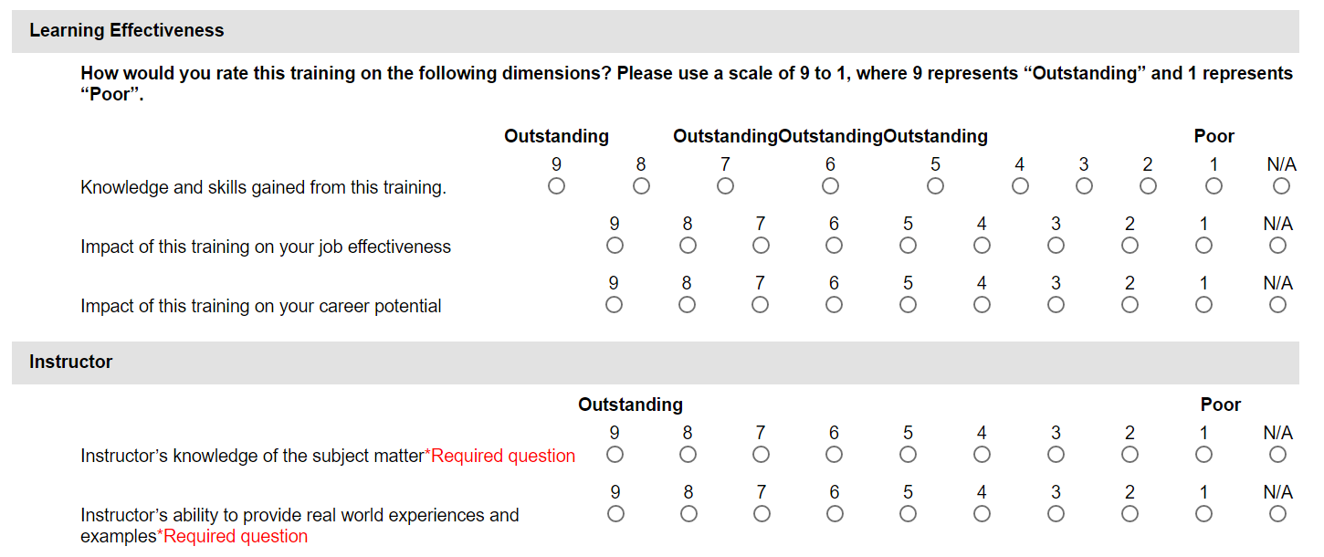
MTM
Notes:
Compared to the anglo saxon grades, there is not connotation or sublimal meaning in it.

Slide 22
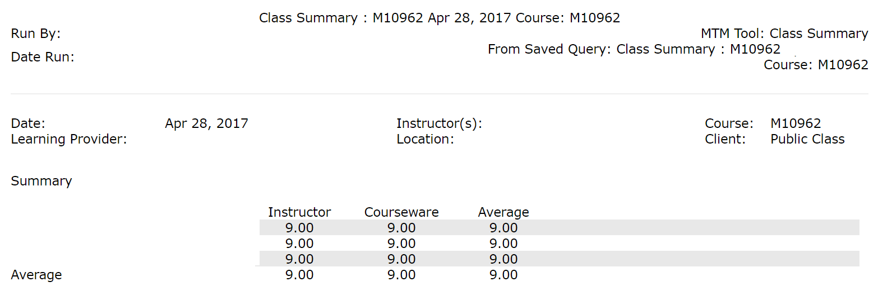
How was it for you, darling?
Notes:
MTM
This is a fantastic score, but what does it say to you?

Slide 23
What's YOUR feeling about grade 2?
Moderate
Almost fail
Familiar Damm Fear Terrible Low F*ck
Can’t remember
Kinder garden
Better than OK - nearly
Harsh
Good Annoying Disappointing
Cute Degrading
Awesome!!!
Grades are stupid
Better than average
Failure
Nostalgic
Unsatisfactory – failed exam
Still happy about School Inferior Bad Poor Rubbish
Investigate & evolve
Elementary
Notes:
Here are the results of what grade 2 makes you feel like.
Guess what the % is for negative, positive, just plain weird and those who had no feelings at all.
38% of grade 2 as a negative grade, 21% as positive, 27% gave weird responses and 15% left it blank.

Slide 24
Resumee, Chapter 2
Marks are numbers charged with social and cultural hidden meanings.
Notes:
Mind the gap.

Slide 25
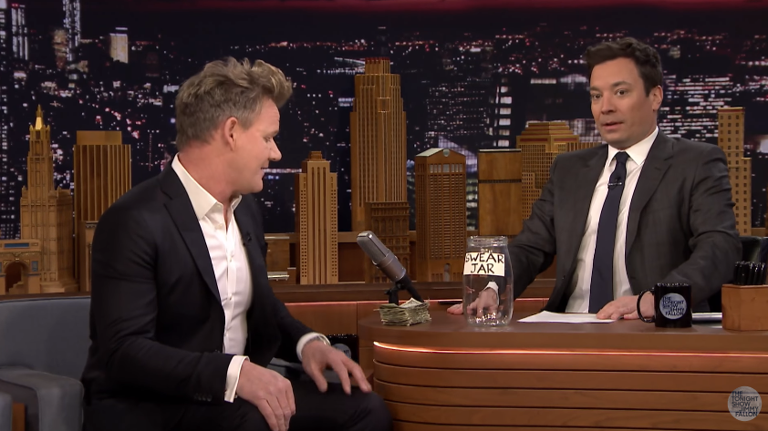
Chapter 3: The don'ts
Click to watch video!
Notes:
https://www.youtube.com/watch?v=wkSYGykMiwE
https://vimeo.com/209069504/2523944e15
To give you an introduction we have a video of an interview from an UK person and an US host. There are German subtitle’s, which we have left, take care of the words that are translated and those not translated. Which ones have beeps.

Slide 26



Vote!
Which of the upcoming phrases would you use "on stage"?
Notes:
Thanks to Heike, we have referee cards for you to hold up. All we want from you is to hold up your ref card – would you say this?
Red = you would not say this, Yellow = medium, Green = okay to say

Slide 27

[01]
I do like this sexy new feature
in OneDrive, formally known
as placeholders.

Slide 28

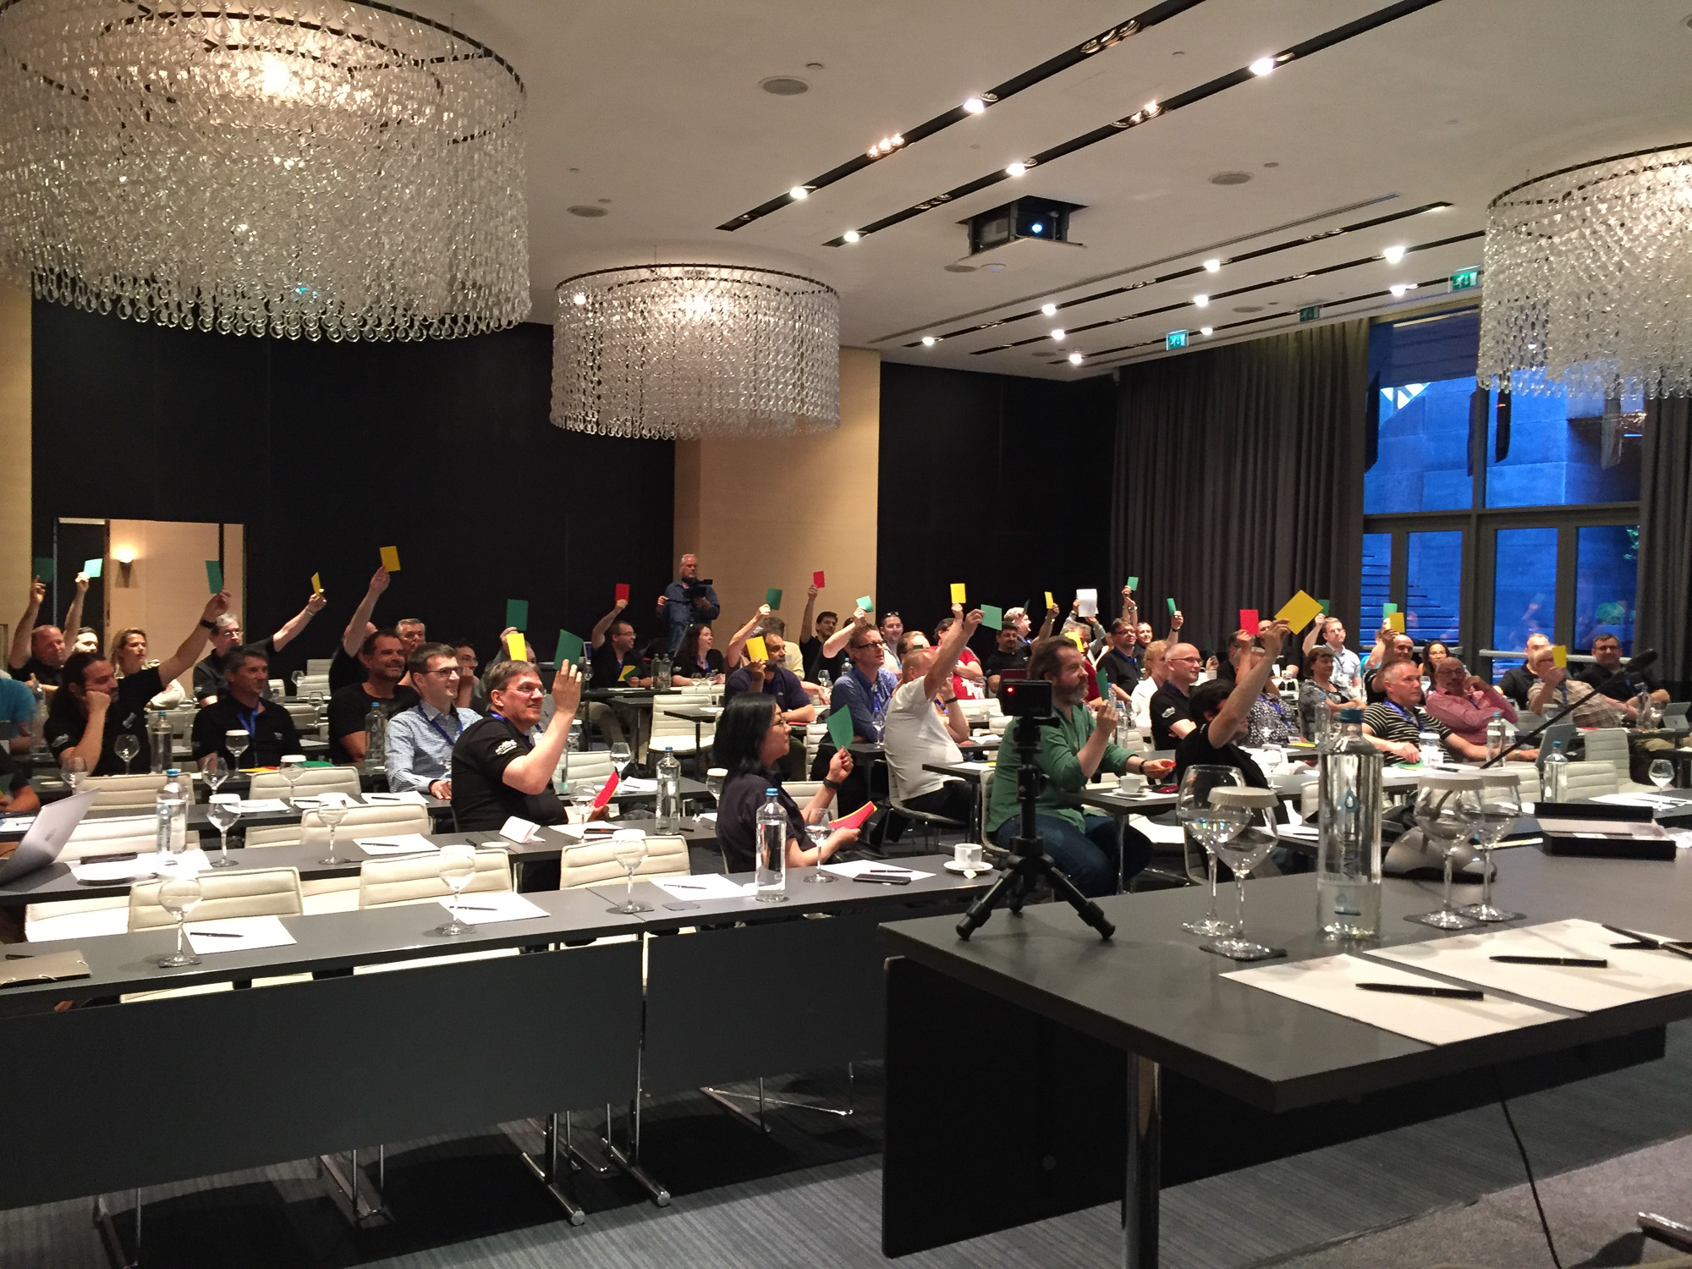
[01]
I do like this sexy new feature in OneDrive, formally known as placeholders.
Notes:
Your vote: dominating green

Slide 29
[02]
You should stop fucking around
with the click UI and start
learning PowerShell.

Slide 30

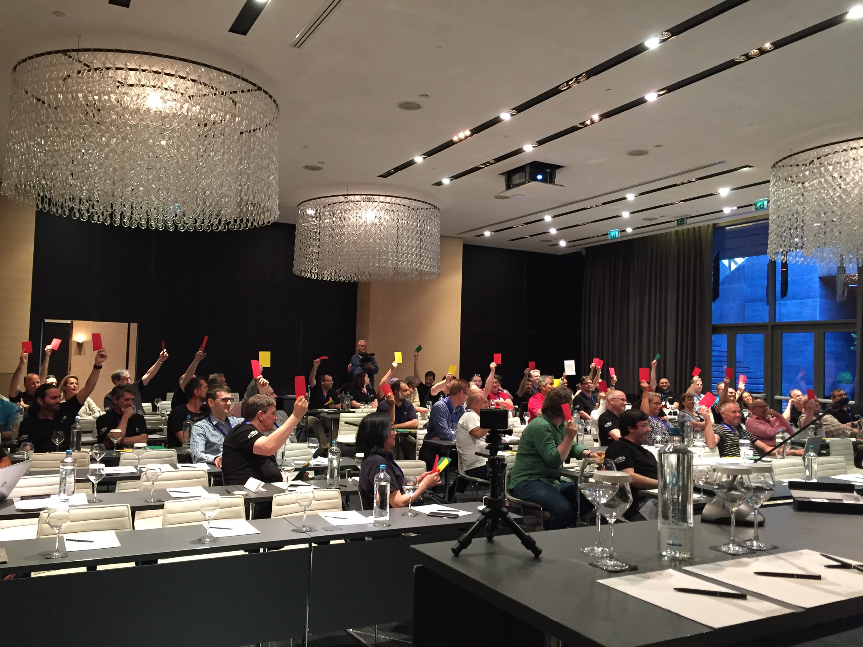
[02]
You should stop fucking around with the click UI and start learning PowerShell.
Notes:
Your vote: red

Slide 31
[03]
I noticed that UK customers don't
care a shit about Hyper-V.

Slide 32
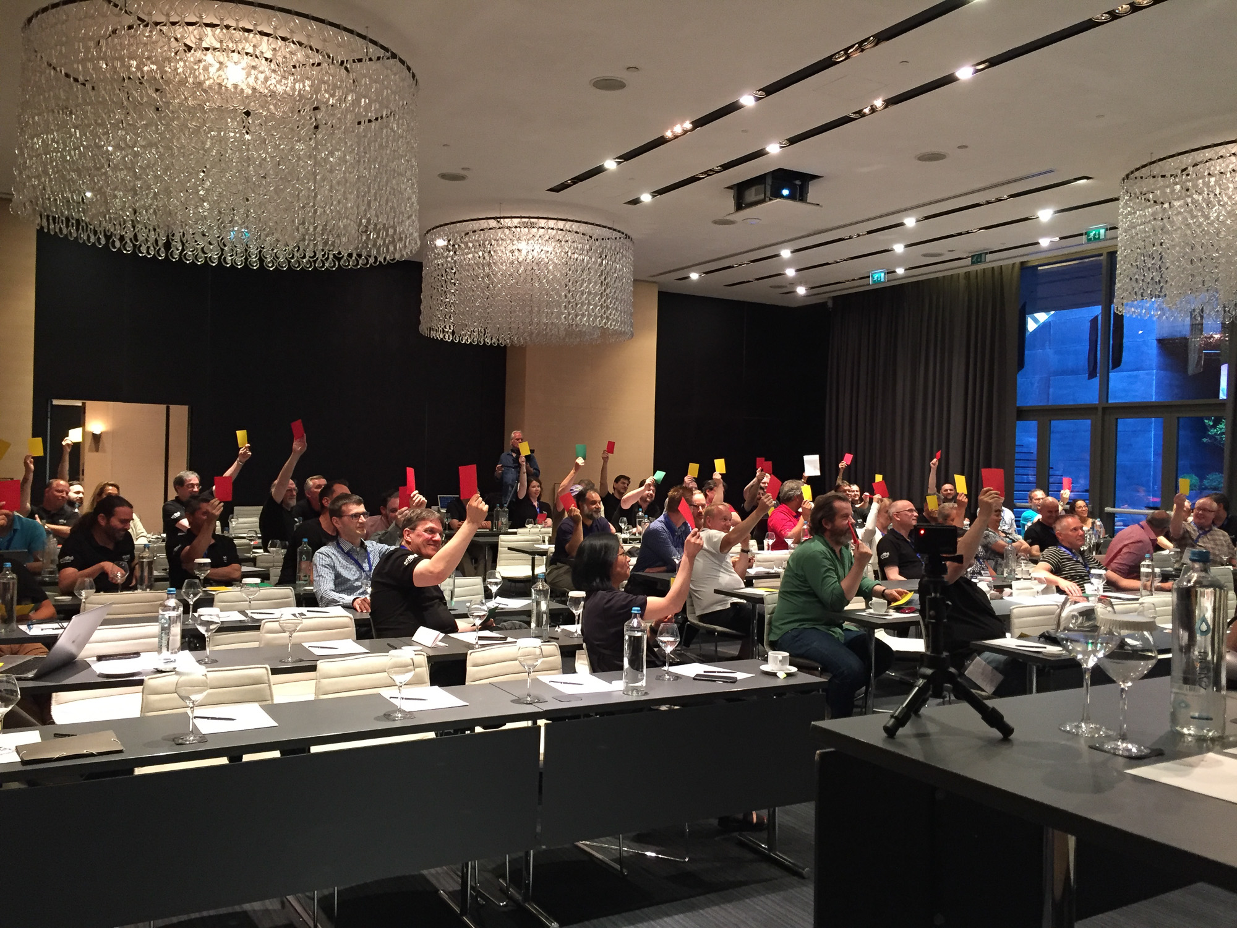
[03]
I noticed that UK customers don't care a shit about Hyper-V.
Notes:
Your vote: mostly red.

Slide 33
[04]
Start teaching Sharepoint was the
stupidest career decision ever.

Slide 34

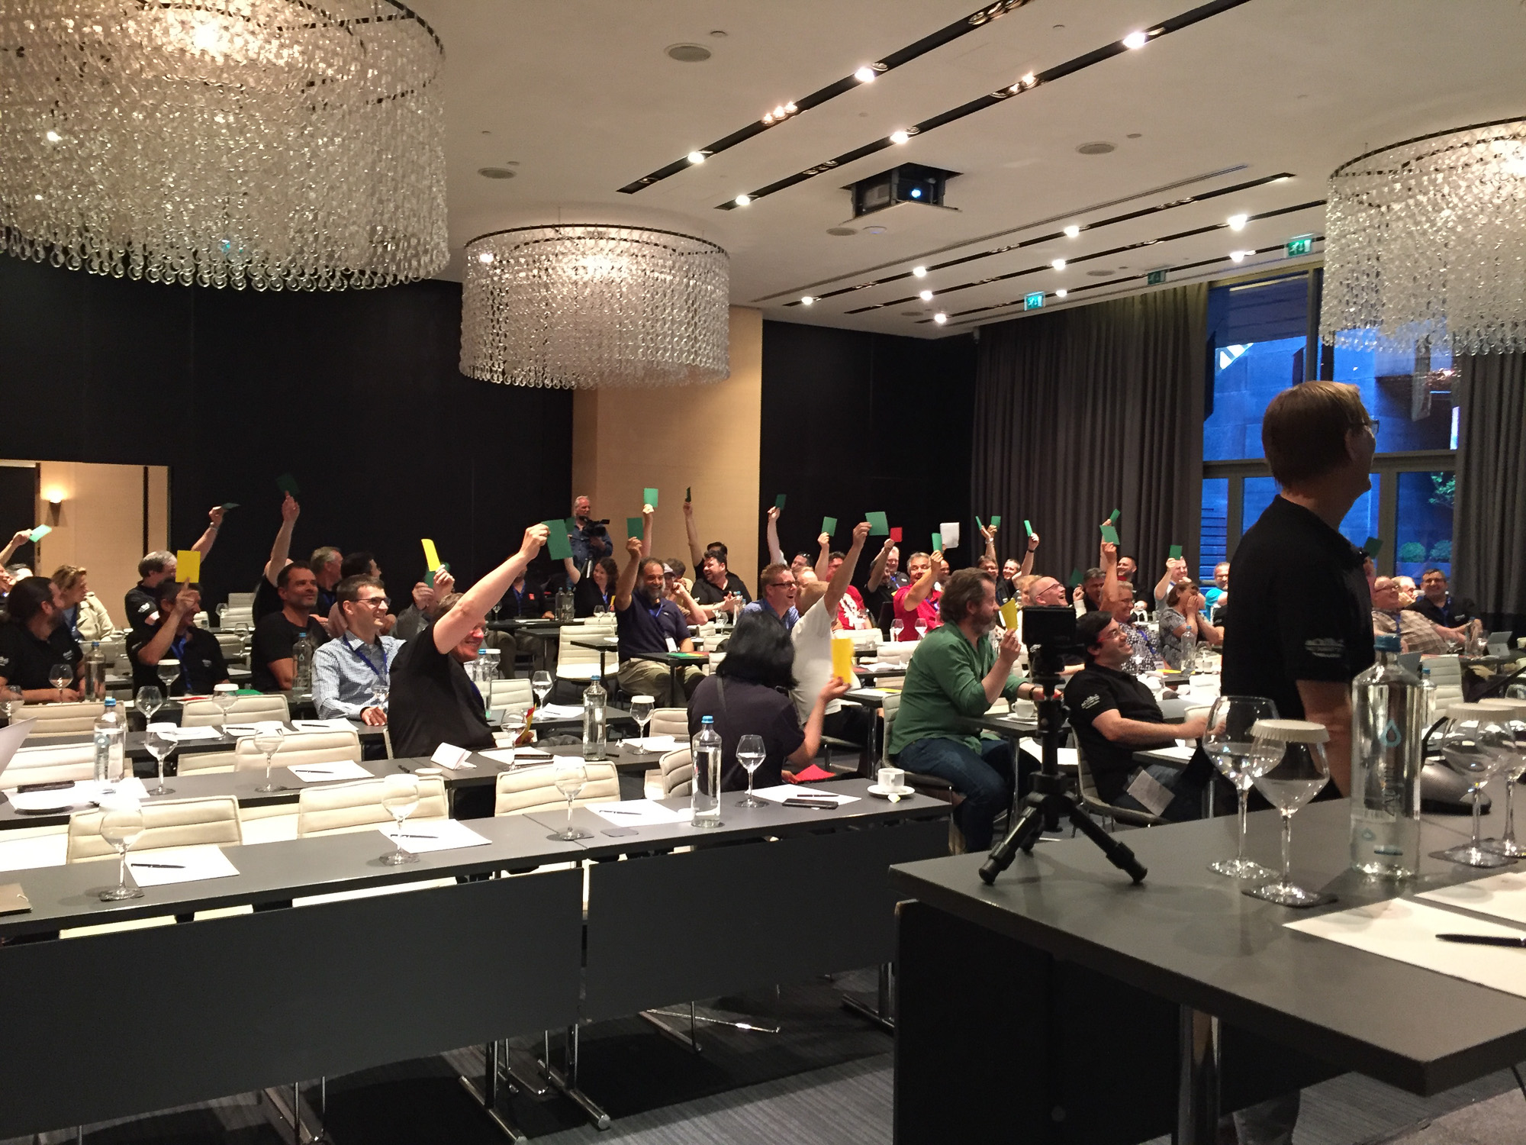
[04]
Start teaching Sharepoint was the stupidest career decision ever.
Notes:
Your vote: dominantly green

Slide 35
[05]
No enterprise agreement ?
You're kidding me, aren't ye?

Slide 36
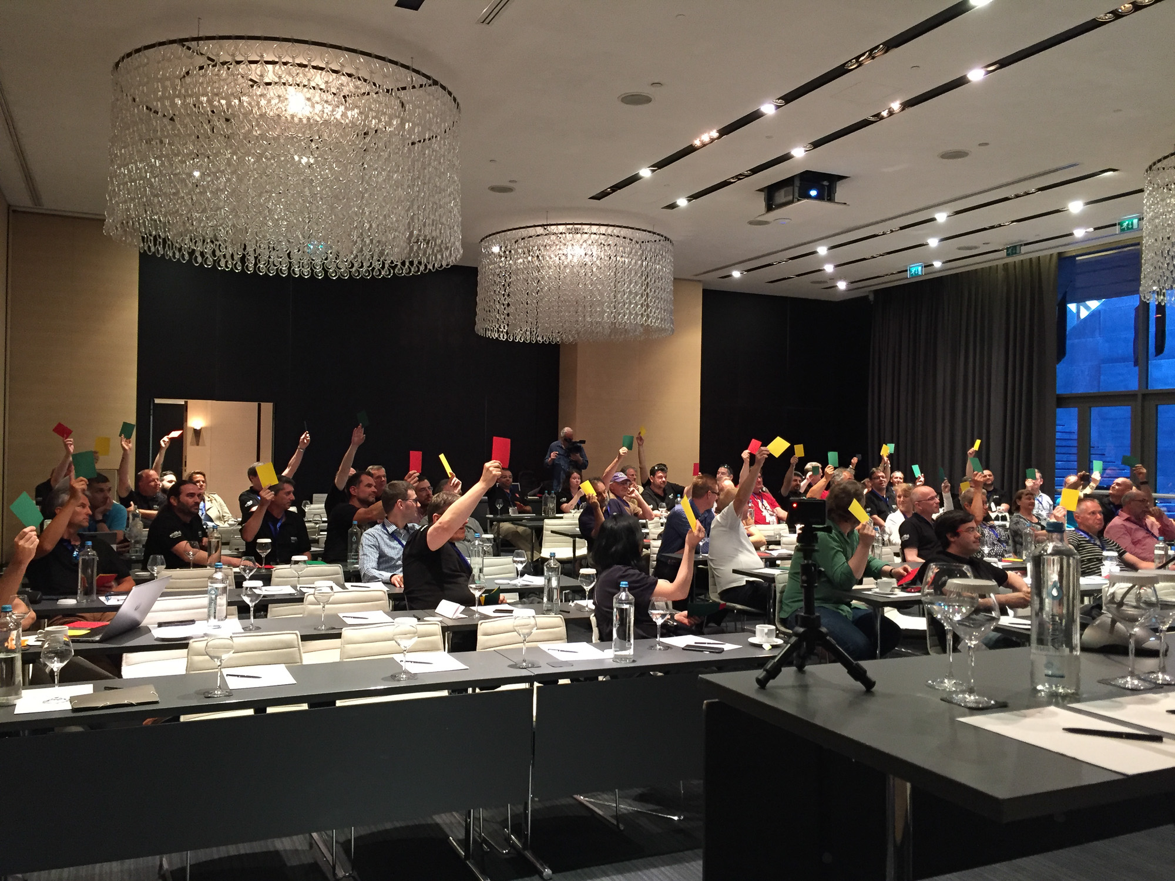
[05]
No enterprise agreement? You're kidding me, aren't ye?
Notes:
your vote: undecided

Slide 37
[06]
Keep in mind: you have to work
with this crap 'til you're 64!

Slide 38
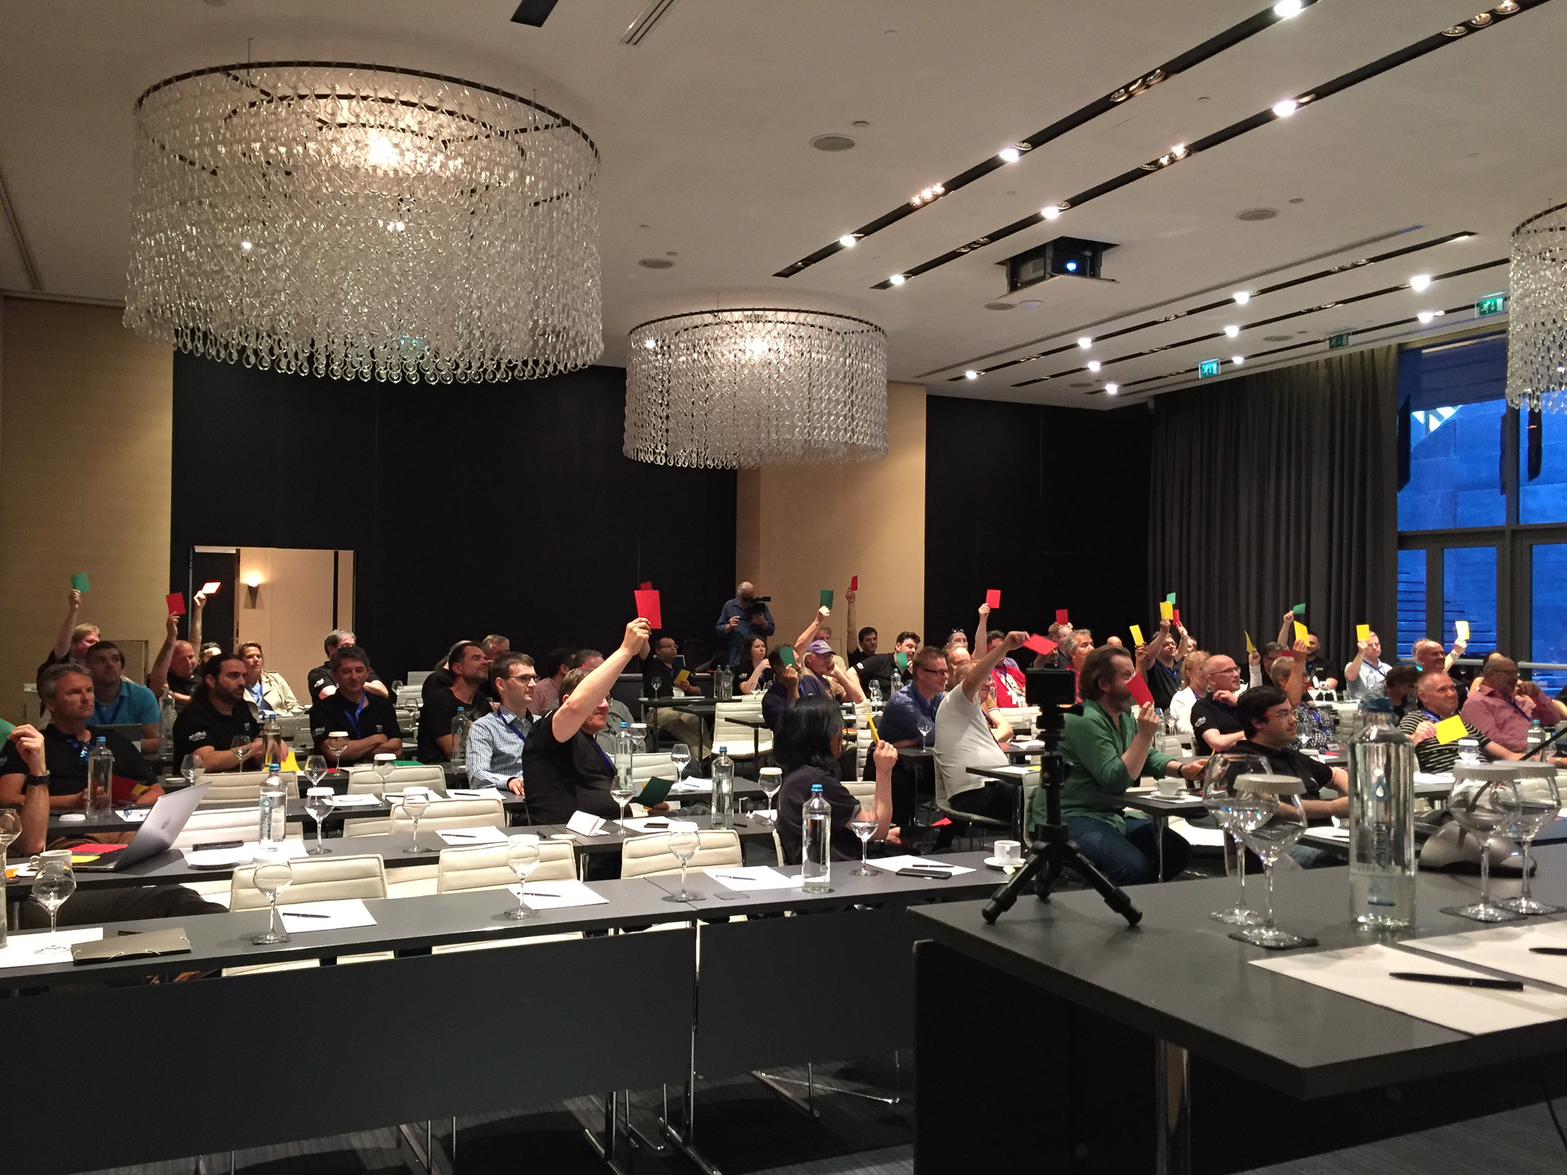
[06]
Keep in mind: you have to work with this crap 'til you're 64!
Notes:
Your vote: mostly red

Slide 39
[07]
Hell freezes over: Windows on Git!

Slide 40
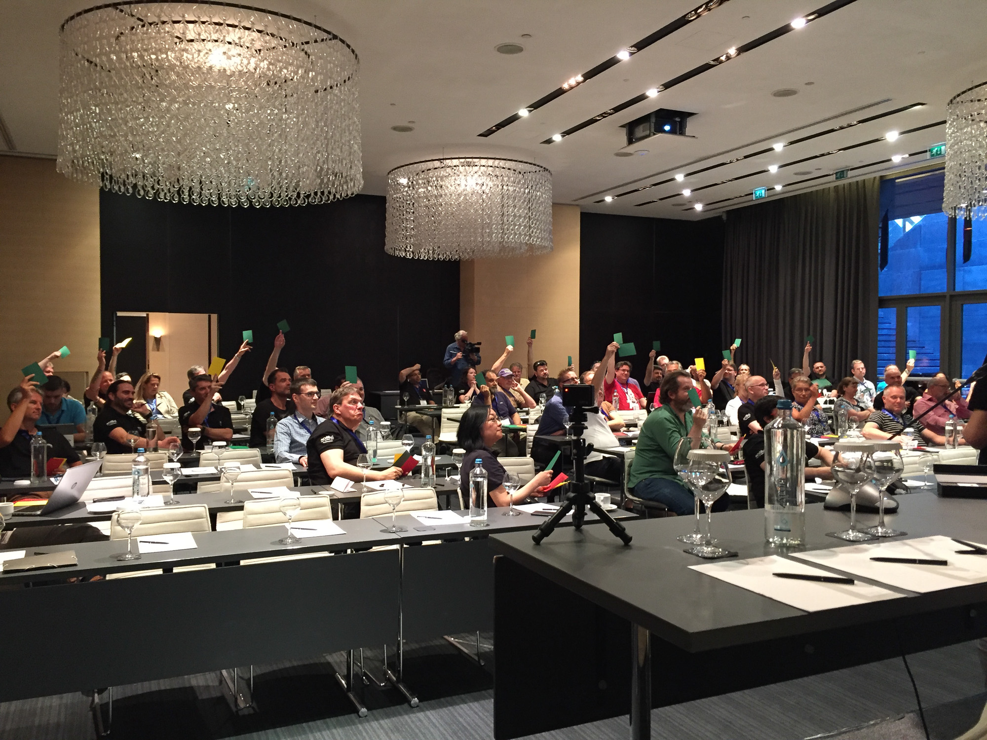
[07]
Hell freezes over: Windows on Git!
Notes:
Your vote: almost green

Slide 41
[08]
I hate it to my guts when
the demo breaks.

Slide 42
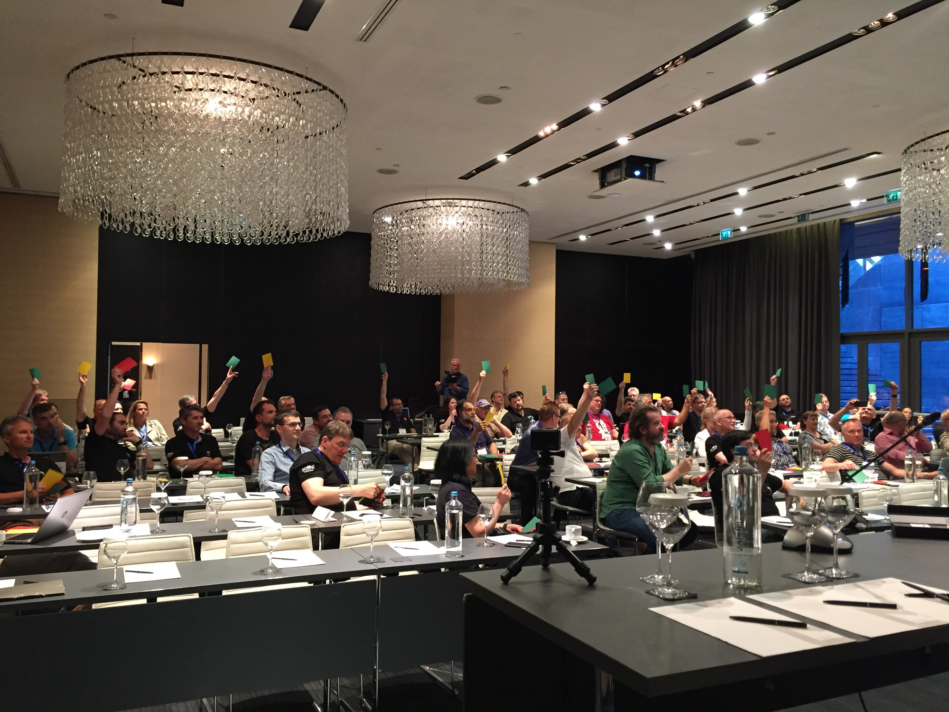
[08]
I hate it to my guts when the demo breaks.
Notes:
Your vote: almost green

Slide 43
[09]
How the heck could I ever have
lived without this awesome new Azure RM template!

Slide 44
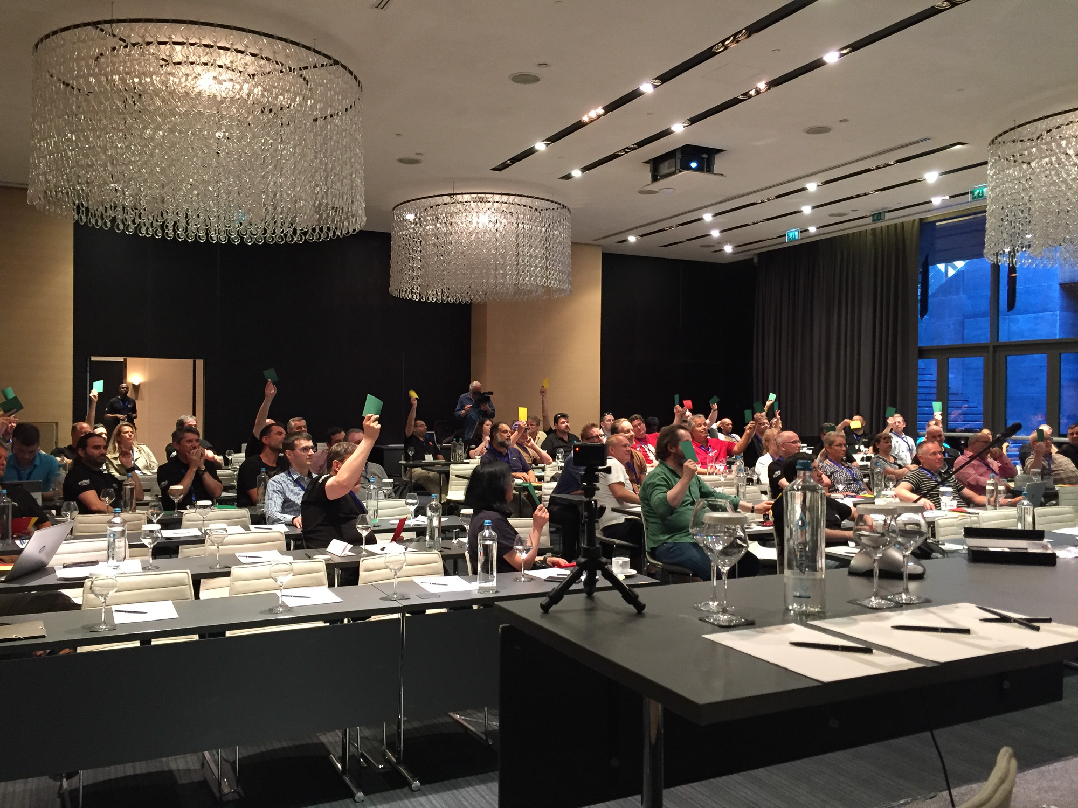
[09]
How the heck could I ever have lived without this awesome new Azure RM template!
Notes:
Your vote: a lot of green plus a a little bit of everything

Slide 45
[10]
For Christ‘s sake, you should never
delay those security updates.

Slide 46
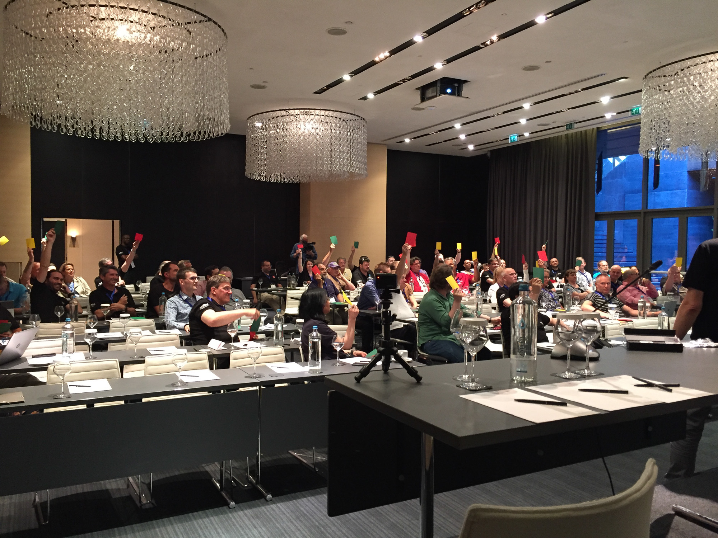
[10]
For Christ‘s sake, you should never delay those security updates.
Notes:
Your vote: somehow yellow ...

Slide 47
[11]
Sorry for the delay, that gpu driver
pissed me off 10 seconds before the presentation.

Slide 48
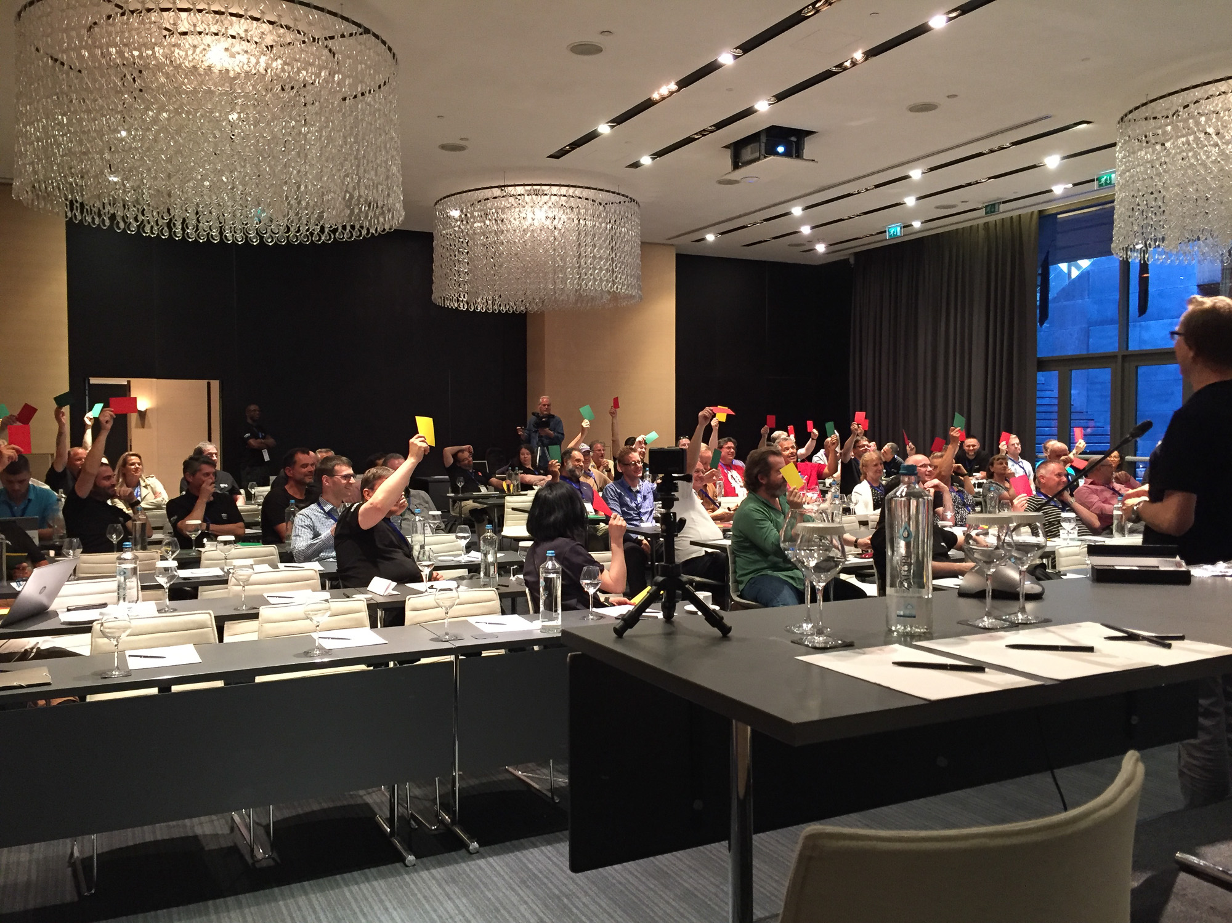
[11]
Sorry for the delay, that gpu driver pissed me off 10 seconds before the presentation.
Notes:
Your vote: undecided

Slide 49
[12]
Horrible implementation.
Without a doubt.

Slide 50
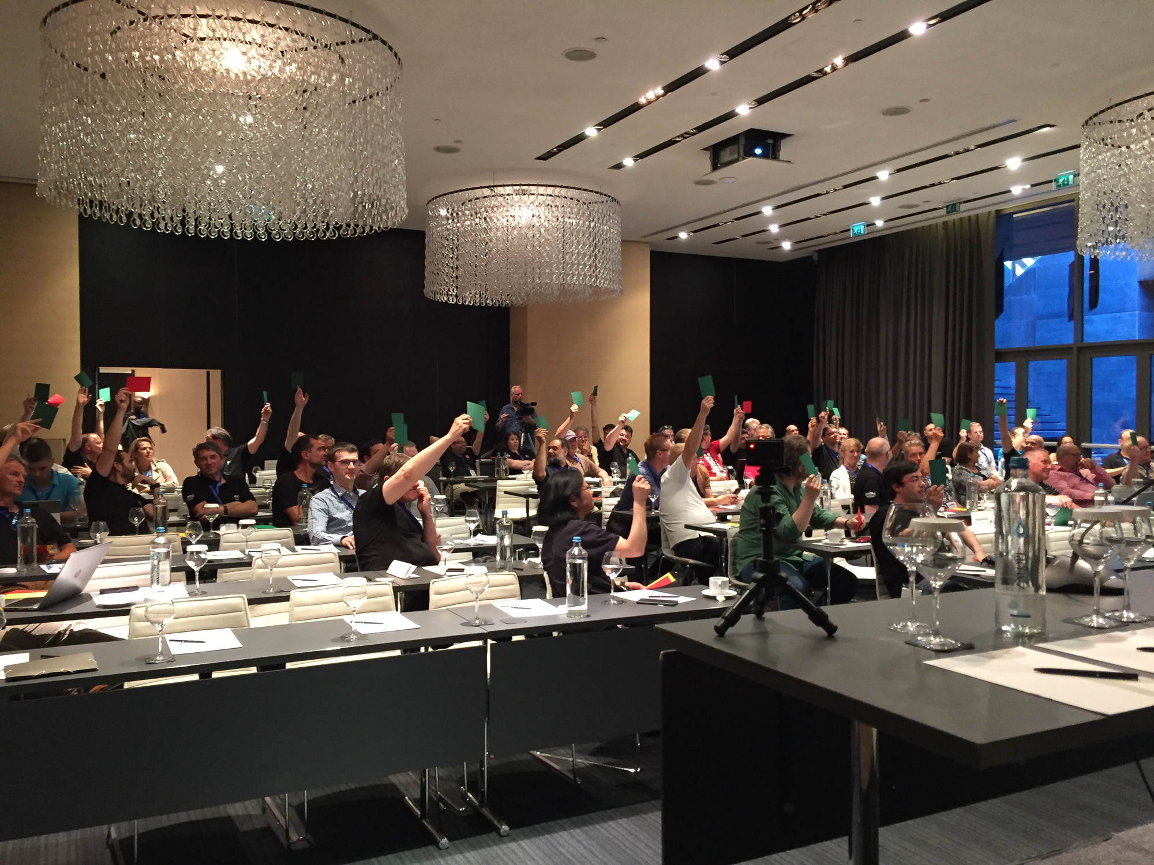
[12]
Horrible implementation. Without a doubt.
Notes:
Your vote: almost green

Slide 51

Shit, Shitless, Crap,
F*ck, F*cking,
Boll*cks, Arse/Ass,
Hell, Christ, Jesus,
Balls, C*nt, Cock,
Piss, B*stard
*Denise can‘t bear to see these on screen
Sexy,
Feck**
**only ok in Ireland ;)
Stupidest, Kidding,
Freaking, Heck, Hate (better to say dislike),
Guts
Notes:
In UK (in particular on BBC radio) there are normally no swear words in songs, they will either leave a small blank or put in a different word. In Europe you always hear the explicit version. How would non native speakers know what is okay or not? For example, there is a song where the words in UK are “Let’s go crazy crazy” in Europe it’s “Let’s go F*cking crazy”.
Read more:
http://www.bbfc.co.uk/what-classification/r18
7 dirty words (USA)
https://en.wikipedia.org/wiki/Seven_dirty_words
shit, piss, fuck, cunt, cocksucker, motherfucker, and tits

Slide 52
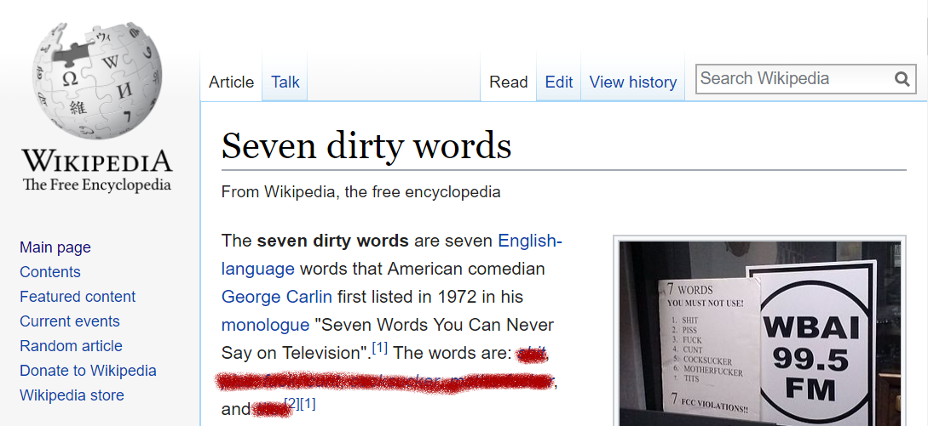
Resumee, Chapter 3
Check your luggage.
https://en.wikipedia.org/wiki/Seven_dirty_words
Notes:
If you don’t believe us, check out this article on Wikipedia

Slide 53
"One cannot not communicate."
Paul Watzlawick

Slide 54
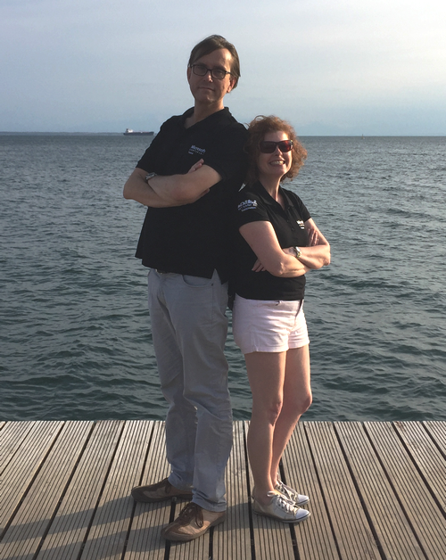

KEEP
CALM
AND
ENJOY
#MCTSUMMIT
Corbel 57, 28

Slide 55

Efcharistoume our sponsors

Slide 56
Ressources
Official recording from MCT Summit 2017: youtube.com/watch?v=KtnBKVfrE9w
All files thorsten-butz.de/mctsummit2017
Jimmy Fallon and Gordon Ramsey The Tonight Show
Soundtrack Sting: Englishmen in New York
Notes:
Official recording from MCT Summit 2017:
youtube.com/watch?v=KtnBKVfrE9w
All files, incl. PPTX file thorsten-butz.de/mctsummit2017
Jimmy Fallon and Gordon Ramsey
# with German subtitles
https://vimeo.com/209069504/2523944e15
# without subtitles
https://www.youtube.com/watch?v=wkSYGykMiwE
Jimmy Fallon: Dr. W.
# with German subtitles
https://vimeo.com/218033318/913dbdf879
# without subtitles
https://www.youtube.com/watch?v=H7wm1v7bm2M

Slide 57
Extra content & deleted slides

Slide 58
Bonus movie: Jimmy Fallon: Dr. W.
Notes:
https://vimeo.com/218033318/913dbdf879
https://www.youtube.com/watch?v=H7wm1v7bm2M

Slide 59
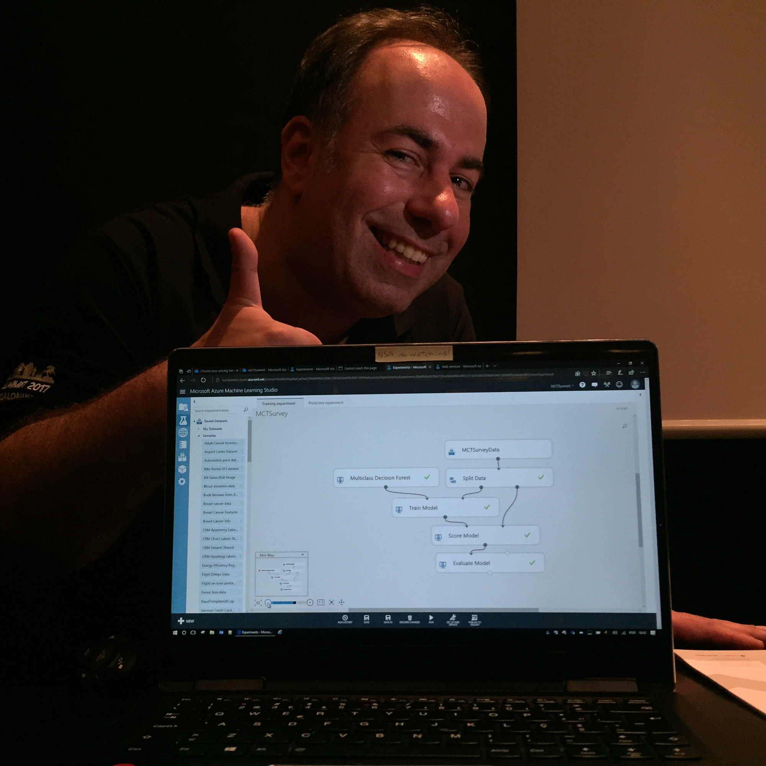
Machine learning with the survey data
André Melancia
"If a machine can learn, why can’t YOU learn Azure Machine Learning?"
http://mctsummit.eu/speakers/machine-can-learn-cant-learn-azure-machine-learning/
Notes:
http://mctsummit.eu/speakers/machine-can-learn-cant-learn-azure-machine-learning/

Slide 60
"We're disappointed too. With consternation.
We see the curtain closed the plot unended"
Bertold Brecht, 1940
Notes:
A draft for those of you who prefer a slightly more intellectual closing statement.

Slide 61
"It's not easy having a good time!"
Dr. Frank N. Furter, 1975
Notes:
Vice vera (see slide before).

Slide 62
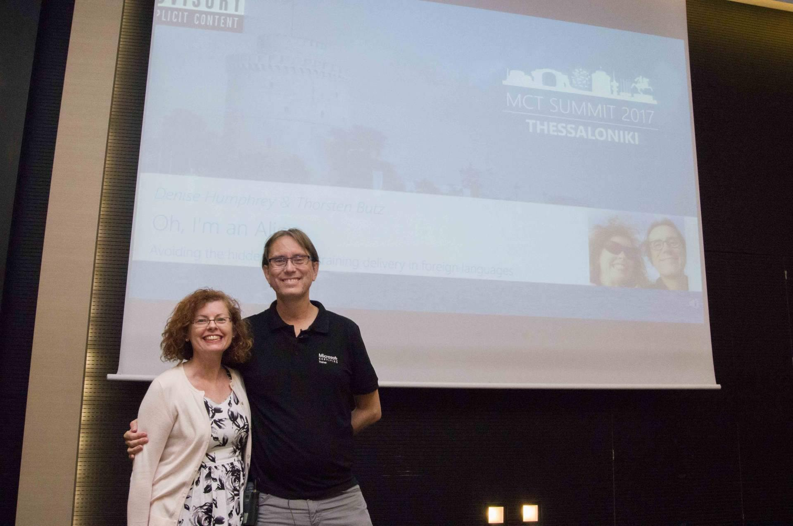
Notes:
Thanks for having us!

